Slide 1
Definition and Meaning of Qualitative Research

Slide 2
Types of Research
Two types of Research :
Qualitative
2. Quantitative

Slide 3
Qualitative Vs. Quantitative
Qualitative
An inquiry which seeks to understand social phenomena through the exploration and interpretation of the meanings people attach to, and make sense of, their experiences of the social world “
Associated with the Interpretive paradigm
Key principle: Subjectivity/interpretation
Theory developed: during and/or after the study (theory generation)
Process: Inductive

Slide 4
Quantitative
An inquiry based on testing a theory composed of variables, measured with numbers and analysed with statistical procedures, in order to determine whether the predictive generalisations of the theory hold true
Associated with: Post/positivist paradigm
Key principle: Objectivity
Theory Production: before the study (theory verification) (Hypotho-deductive)
Process: Deductive

Slide 5
Qualitative perspective:
‘‘The systematic collection, organization, and interpretation of textual material derived from talk or conversation. It is used in the exploration of meanings of social phenomena as experienced by individuals themselves, in their natural context’’
(Malterud, 2001, p. 483).

Slide 6


Slide 7
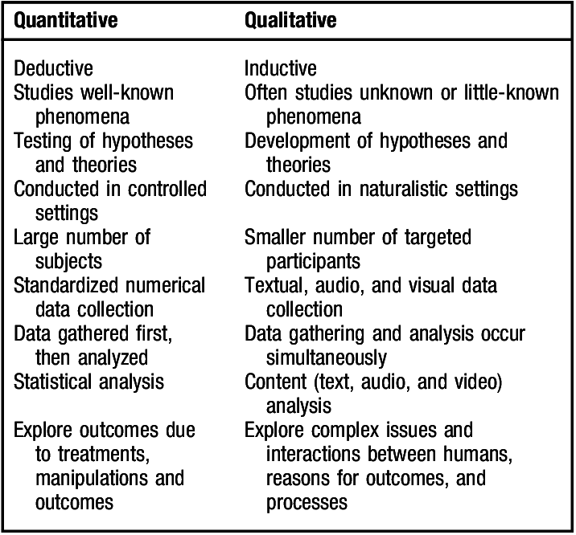
Difference bt Qualitative & Quantitative Research

Slide 8
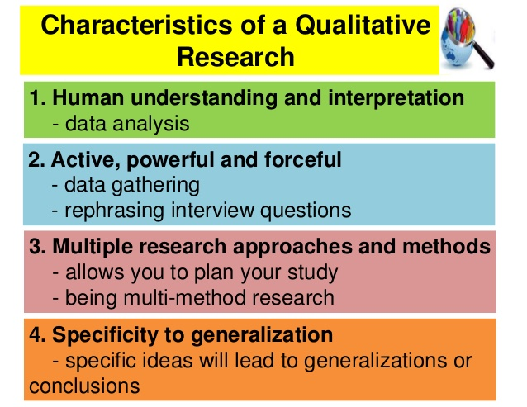
Characteristics of Qualitative Research

Slide 9
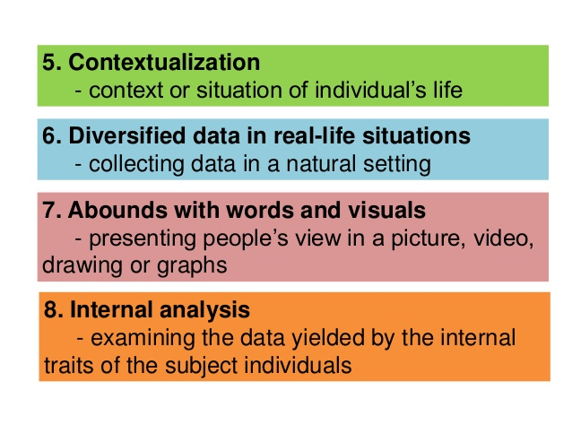

Slide 10
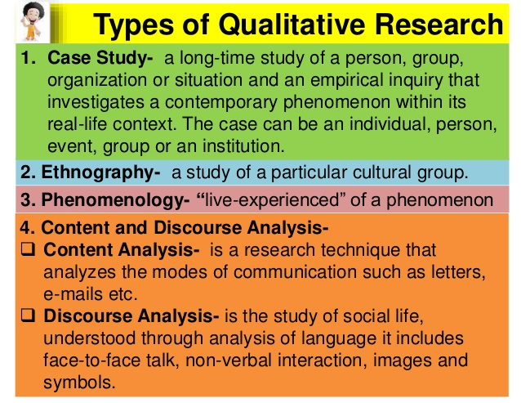

Slide 11
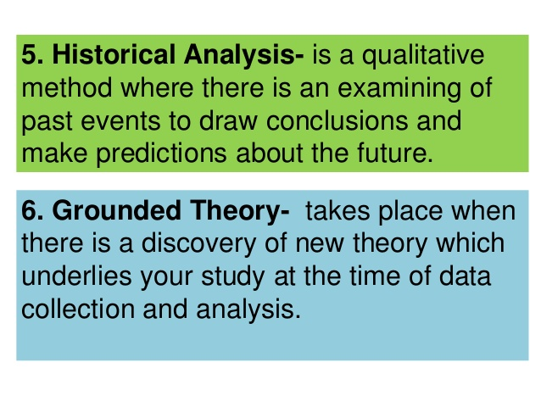

Slide 12
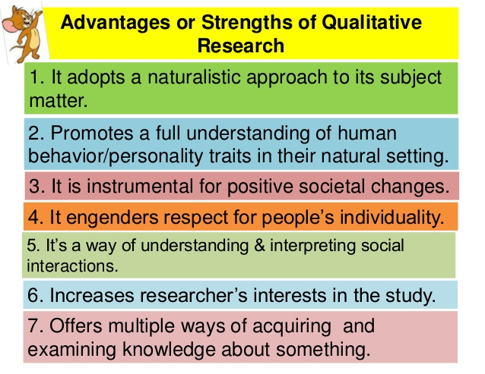

Slide 13
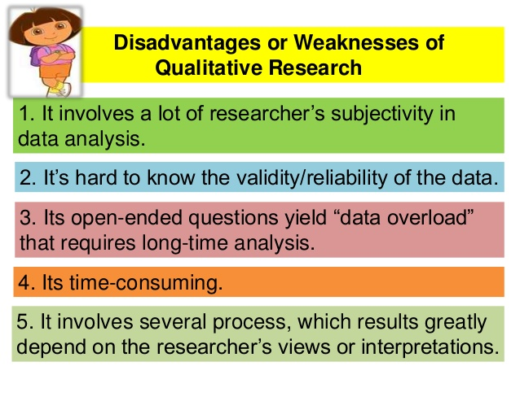

Slide 14
